Slide 1

Chapter 5 Session 1 + 2
Get Off A Fast Start With jQuery
Notes:
Session: Ghi số thứ tự session trong môn học
Session Name: ghi tên của session sẽ dạy

Slide 2
Objectives
Introduction to jQuery
The basic of jQuery programming
The Email List application in jQuery
A working subset of selectors, methods and event methods
Three illustrative applications
Notes:
Mô tả nội dung mà học viên phải đạt được khi kết thúc môn học này

Slide 3
Introduction to jQuery
Notes:
Session: Ghi số thứ tự session trong môn học
Session Name: ghi tên của session sẽ dạy

Slide 4
What jQuery is
jQuery is a free, open-source, JavaScript library that provides methods that make JavaScript programming easier.
What jQuery offers:
Dozens of selectors, methods and event methods that make it easier to add JavaScript features to your web pages
Cross-browser compatibility
Selectors that are compliant with CSS3
A compressed library that loads quickly

Slide 5
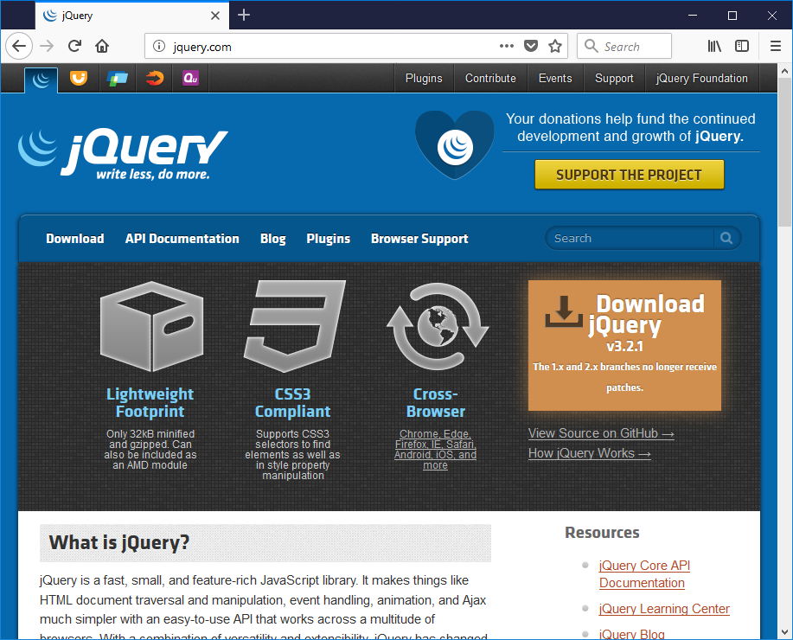
What jQuery is (cont.)
The jQuery website at jquery.com

Slide 6
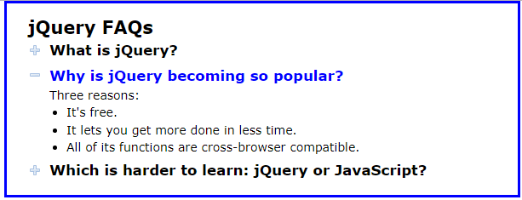
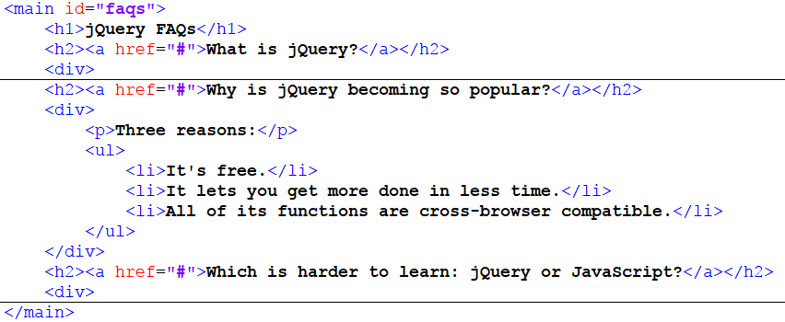
A simple jQuery application
Web interface
HTML code

Slide 7
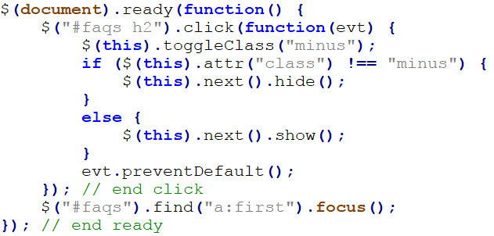
A simple jQuery application (cont.)
The jQuery code for the application

Slide 8
The basic of jQuery programming

Slide 9
How to include jQuery in your web pages
Before use jQuery you must include libray file to your web page.
You can download libray file from jquery.com or use it from CDN(Content Delivery Network).
Include jQuery 3.1.1 after download
<script src = “jquyery-3.1.1.min.js”></script>
Include jQuery 3.11 from a CDN
<script src =“https://code.jquery.com/jquyery-3.1.1.min.js”> </script>

Slide 10

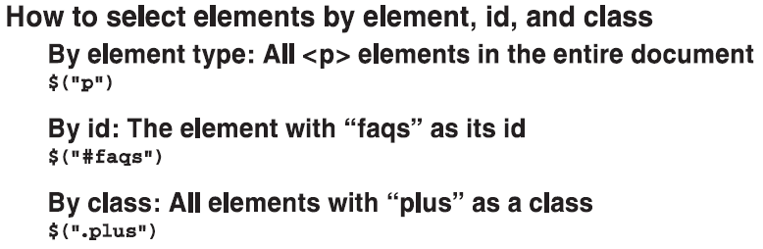
How to code jQuery selectors
The sign ($) is used to refer to the jQuery library.
The selectors used same in CSS syntax.

Slide 11
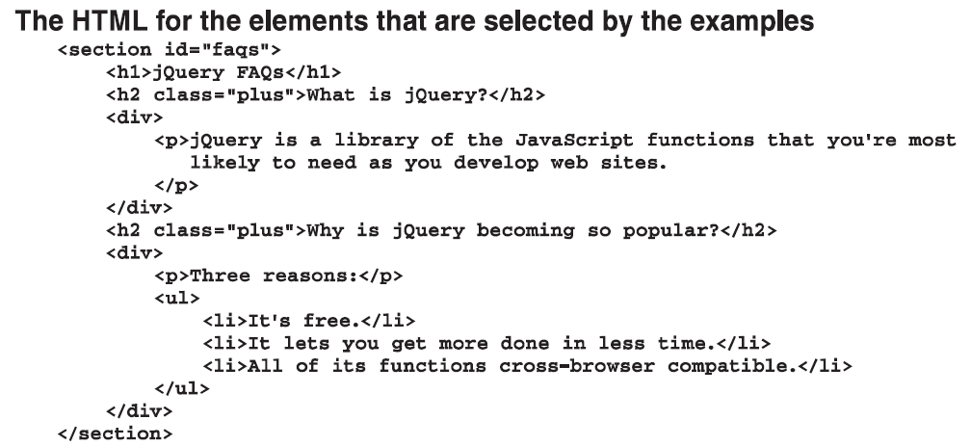
How to code jQuery selectors (cont.)

Slide 12
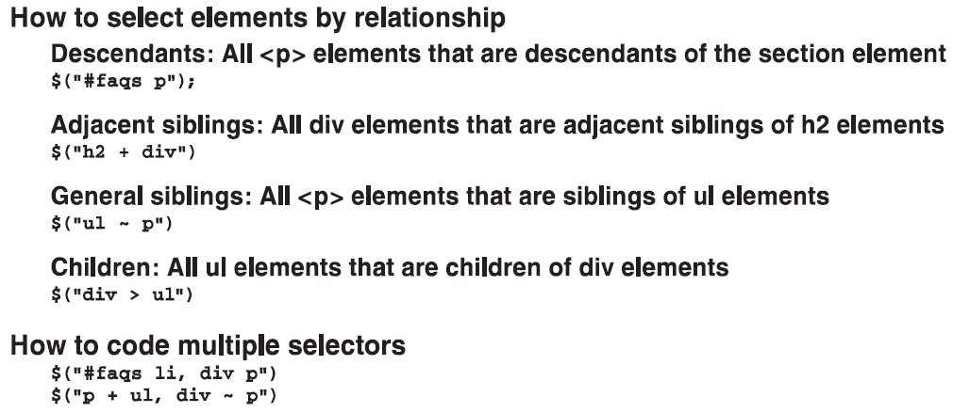
How to code jQuery selectors (cont.)

Slide 13
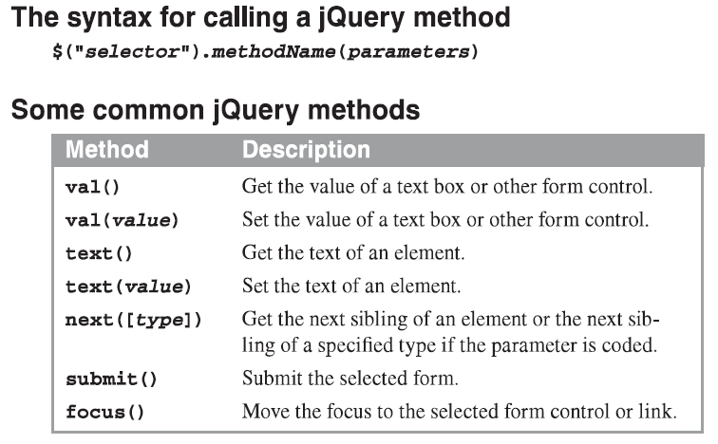
How to call jQuery methods

Slide 14
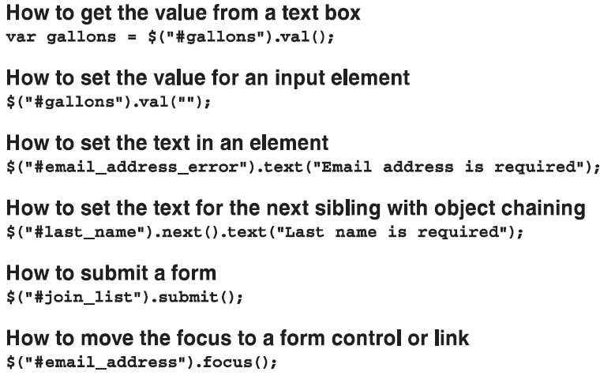
How to call jQuery methods (cont.)

Slide 15
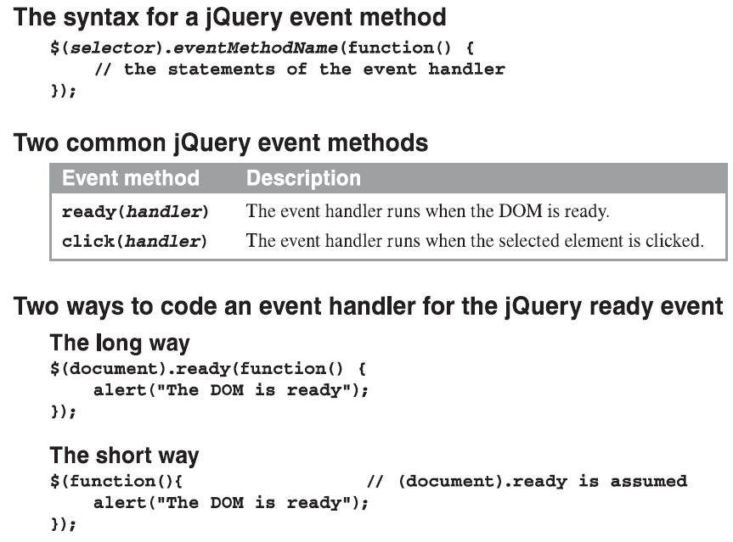
How to use jQuery event methods

Slide 16
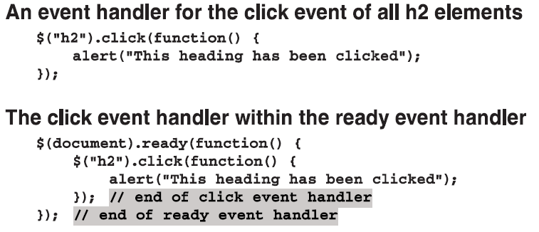
How to use jQuery event methods (cont.)

Slide 17
The Email List application in jQuery
Notes:
Session: Ghi số thứ tự session trong môn học
Session Name: ghi tên của session sẽ dạy

Slide 18
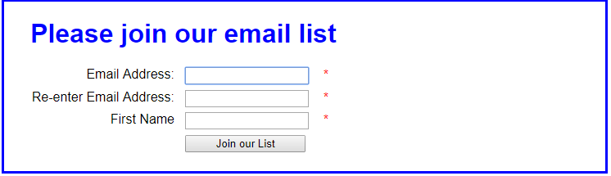
The Email List application in jQuery
The web interface

Slide 19
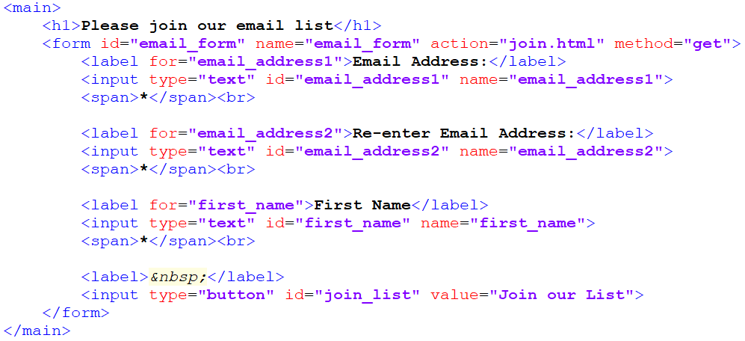
The Email List application in jQuery (cont.)
The HTML code

Slide 20
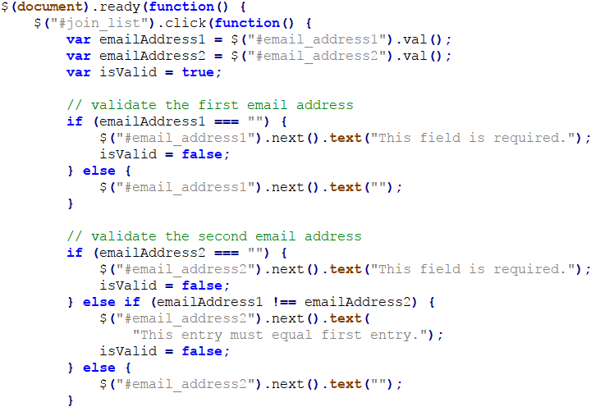
The Email List application in jQuery (cont.)
The jQuery code

Slide 21
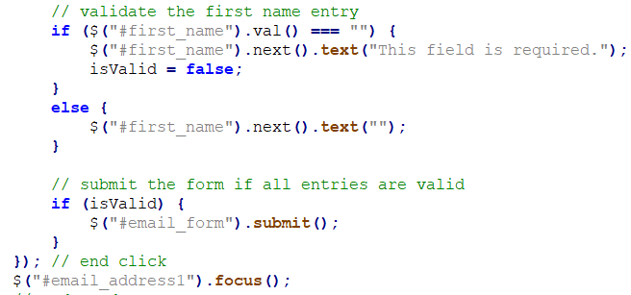
The Email List application in jQuery (cont.)
The jQuery code

Slide 22
A working subset of selectors,
Methods, and event methods
Notes:
Session: Ghi số thứ tự session trong môn học
Session Name: ghi tên của session sẽ dạy

Slide 23
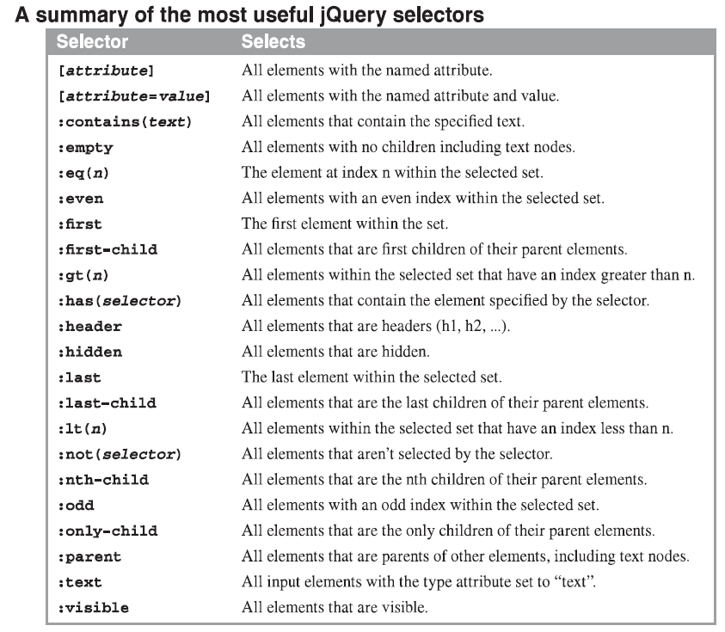
The most useful selectors
Notes:
https://www.w3schools.com/jquery/trysel.asp

Slide 24
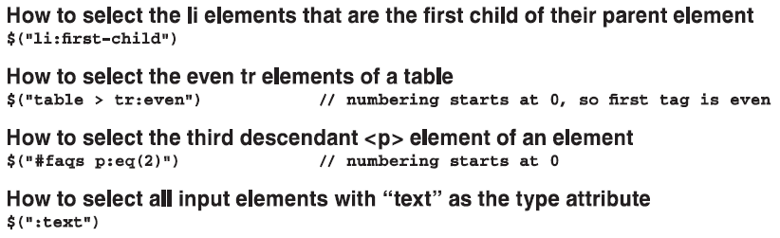
The most useful selectors (cont.)

Slide 25
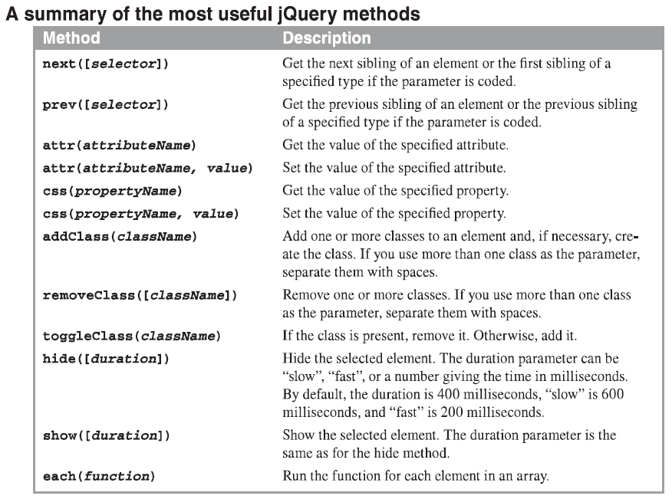
The most useful methods

Slide 26
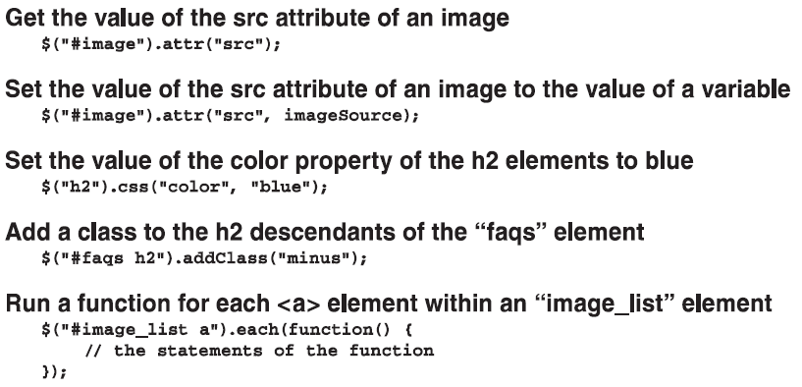
The most useful methods (cont.)

Slide 27
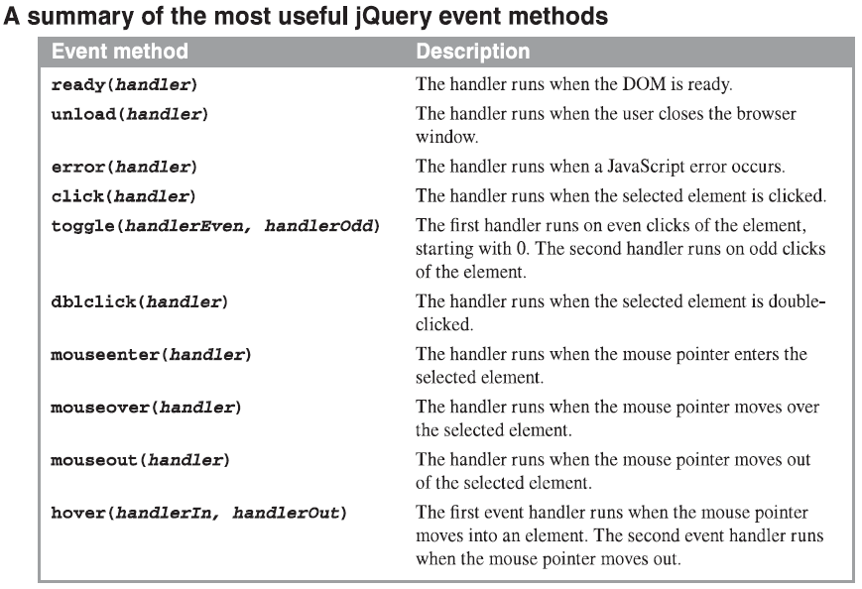
The most useful event methods

Slide 28
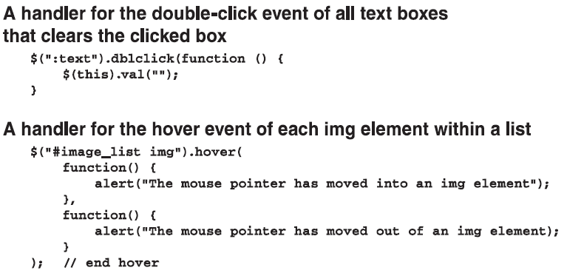
The most useful event methods (cont.)

Slide 29
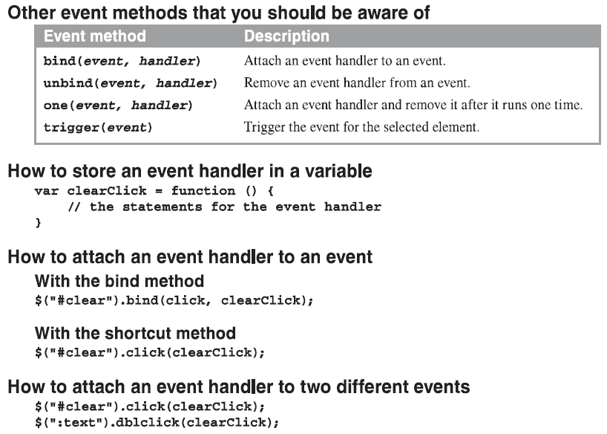
Other event methods that you should be aware of

Slide 30
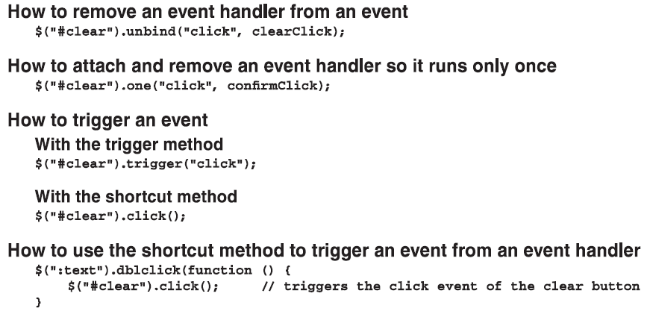
Other event methods that you should be aware of (cont.)

Slide 31
Three illustrative applications
Notes:
Session: Ghi số thứ tự session trong môn học
Session Name: ghi tên của session sẽ dạy

Slide 32
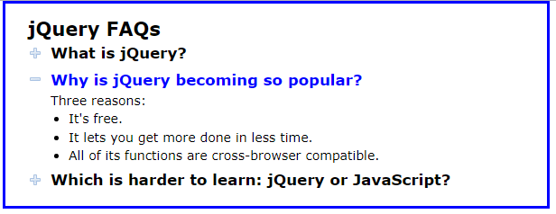
The FAQs application jQuery
The web interface

Slide 33
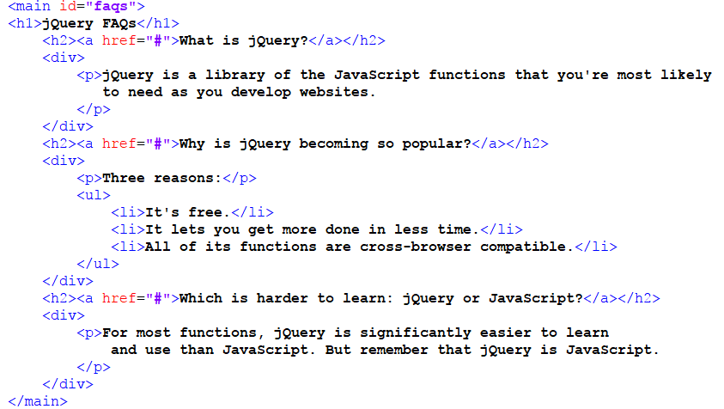
The FAQs application jQuery(cont.)
The html code

Slide 34
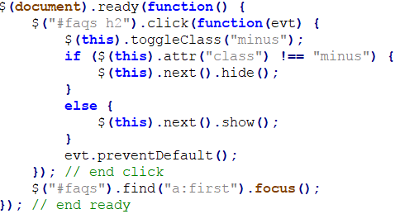
The FAQs application jQuery(cont.)
The jQuery code

Slide 35

The Image Swap application
The web interface

Slide 36
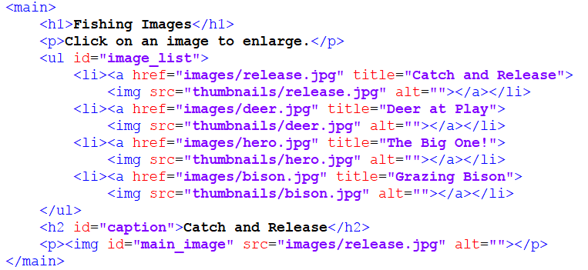
The Image Swap application (cont.)
The HTML code

Slide 37
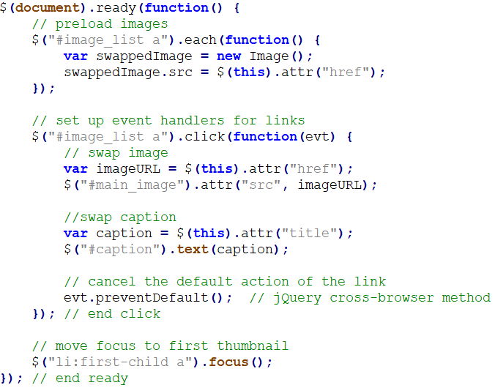
The Image Swap application (cont.)
The jQuery code

Slide 38
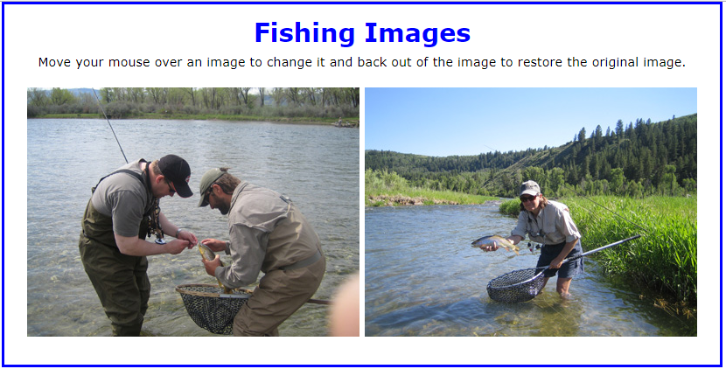
The Image Rollover application
The web interface

Slide 39
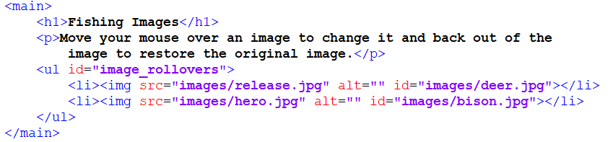
The Image Rollover application (cont.)
The HTML code

Slide 40
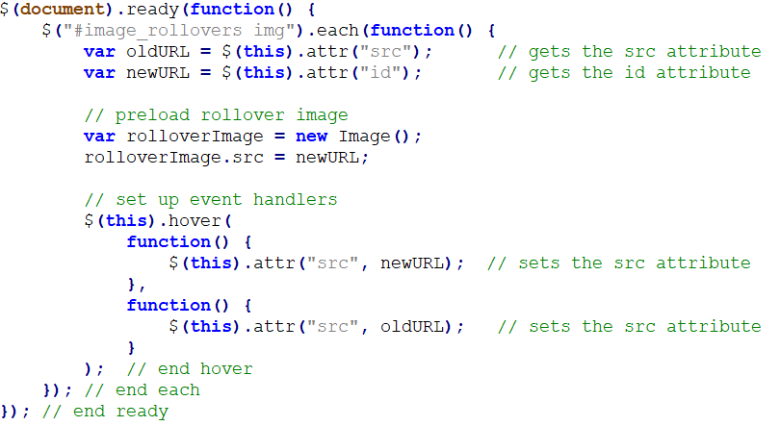
The Image Rollover application (cont.)
The jQuery code

Slide 41
Summary
jQuery is a free, open-source, JavaScript library that provides methods that make JavaScript programming easier.
Before use jQuery you must include libray file to your web page. You can download or use CDN to include jQuery file.
The sign ($) is used to refer to the jQuery library.
The selectors used same in CSS syntax.
Notes:
Tóm tắt lại nội dung đã học

Slide 42
The End.

